Slide 1

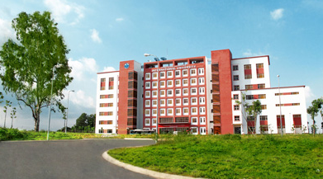
International University
MICRO-PROCESSING SYSTEM
Lecture 7B:
LCD Programming in C
Vo Minh Thanh, M.Eng
School Of Electrical Engineering

Slide 2
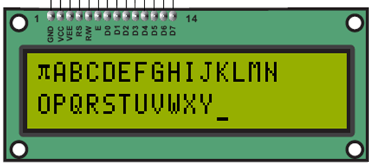
TABLE-1 44780 Based LCD Pin out
PIN | SYMBOL | I/O | DESCRIPTION
1 | VSS | - | Power supply (GND)
2 | VCC | - | Power supply (VDD) (+5V)
3 | VEE | - | Contrast Settings (0~2V)
4 | RS | I | 0 = Select command reg. 1 = Select data reg. of LCD
5 | R/W | I | 0 = Write to LCD 1 = Read from LCD
6 | E | I | The Enable (E) line allows access to the display through R/W and RS lines. 0 = Access to LCD disabled, 1 = Access to LCD enabled
7 | DB0 | I/O | Data bit line 0 (LSB)
8 | DB1 | I/O | Data bit line 1
9 | DB2 | I/O | Data bit line 2
10 | DB3 | I/O | Data bit line 3
11 | DB4 | I/O | Data bit line 4
12 | DB5 | I/O | Data bit line 5
13 | DB6 | I/O | Data bit line 6
14 | DB7 | I/O | Data bit line 7 (MSB)

Slide 3
Table-2 HD44780 instruction set
Instruction | Code |  |  |  |  |  |  |  |  |  | Description | Exec-ution time**
 | RS | R/W | DB7 | DB6 | DB5 | DB4 | DB3 | DB2 | DB1 | DB0
Clear display | 0 | 0 | 0 | 0 | 0 | 0 | 0 | 0 | 0 | 1 | Clears display and returns cursor to the home position (address 0). | 1.64 mS
Cursor home | 0 | 0 | 0 | 0 | 0 | 0 | 0 | 0 | 1 | * | Returns cursor to home position (address 0). Also returns display being shifted to the original position. DDRAM contents remain unchanged. | 1.64 mS
Entry mode set | 0 | 0 | 0 | 0 | 0 | 0 | 0 | 1 | I/D | S | Sets cursor move direction (I/D), also specifies to shift the display (S) or not. These operations are performed during data read/write. | 40uS
 | ID=1/0:right(incr)/left(decr), S=1/0:with/without text
Display On/Off control | 0 | 0 | 0 | 0 | 0 | 0 | 1 | D | C | B | Sets On/Off of all display (D), cursor On/Off (C) and blink of cursor position character (B). | 40uS
 | D,C,B=1/0:Display,Cursor,Blink on/off
Cursor/display shift | 0 | 0 | 0 | 0 | 0 | 1 | S/C | R/L | * | * | Sets cursor-move or display-shift (S/C), shift direction (R/L). DDRAM contents remain unchanged. | 40uS
 | SC=1/0:text/Cursor to RL=1/0:right/left)
Function set | 0 | 0 | 0 | 0 | 1 | DL | N | F | * | * | Sets interface data length (DL), number of display line (N) and character font(F). | 40uS
 | DL=1/0:8/4-bit bus, N=1/0:both lines/one line
Set CGRAM address | 0 | 0 | 0 | 1 | Character Generator RAM address |  |  |  |  |  | Sets the CGRAM address. CGRAM data is sent and received after this setting. | 40uS
Set DDRAM address | 0 | 0 | 1 | Display Data RAM address |  |  |  |  |  |  | Sets the DDRAM address. DDRAM data is sent and received after this setting. | 40uS
Read busy-flag and address counter | 0 | 1 | BF | CGRAM / DDRAM address |  |  |  |  |  |  | Reads Busy-flag (BF) indicating internal operation is being performed and reads CGRAM or DDRAM address counter contents (depending on previous instruction). | 0uS
 | BF=1/0:busy/not busy
Write to CGRAM or DDRAM | 1 | 0 | Character Byte |  |  |  |  |  |  |  | Writes a character to last (CG or DD) RAM address chosen. | 40uS
Read from CGRAM or DDRAM | 1 | 1 | Character Byte |  |  |  |  |  |  |  | Read data from last (CG or DD) RAM address chosen. | 40uS

Slide 4
TABLE-4 44780 Based LCD Types Character Locations
LCD | Character Positions | DDRAM Address
16x2 | 00 01 02 03 – 04 05 06 07 08 09 10 11 – 12 13 14 15 | 80 81 82 83 – 84 85 86 87 88 89 8A 8B – 8C 8D 8E 8F
 | 00 01 02 03 – 04 05 06 07 08 09 10 11 – 12 13 14 15 | C0 C1 C2 C3 – C4 C5 C6 C7 C8 C9 CA CB – CC CD CE CF
20x1 | 00 to 19 | 80 to 93
20X2 | 00 to 19 | 80 to 93
 | 00 to 19 | C0 to D3
20X4 | 00 to 19 | 80 to 93
 | 00 to 19 | C0 to D3
 | 00 to 19 | 94 to A7
 | 00 to 19 | D4 to E7
40X2 | 00 to 39 | 80 to A7
 | 00 to 39 | C0 to E7

Slide 5
Sending Command and Data to LCD
Data
E
195 ns
10 ns
R/W
140 ns
450 ns
10 ns
RS
140 ns
10 ns
Figure: LCD Timing for Write (H-to-L for E line)

Slide 6
8-Wire LCD Programming (1/4)
#include <avr/io.h>
#include <util/delay.h>
#define RS 0 // bit 0 of Port
#define RW 1 // bit 1 of Port
#define E 2 // bit 2 of Port
#define DATA_BUS PORTD
#define DATA_DDR DDRD
#define CTRL_BUS PORTC
#define CTRL_DDR DDRC
void delay(unsigned int z) // For delay when LCD Starts
{ unsigned int x;
for(x=0 ; x<z ; x++)
_delay_ms(10);
} //Delay Function Ends
int ready(){ //For checking that the LCD is ready or not?
delay(10); return 1;
} //Ready Function Ends

Slide 7
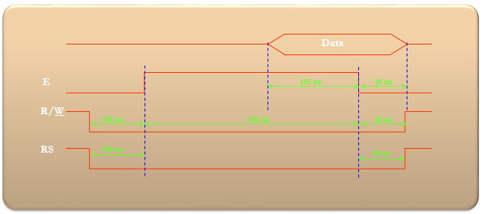
8-Wire LCD Programming (2/4)
void LCD_Pulse_E(int t){
CTRL_BUS |= 0b00000100 ; // E = 1;
delay(t);
CTRL_BUS &= 0b11111011 ; // E = 0;
delay(t);
}
int LCD_Command(unsigned char COMMAND){
ready();
DATA_BUS = COMMAND;
CTRL_BUS = 0b11111000;
LCD_Pulse_E(1);
return 1;
}
int LCD_Show(unsigned char CHARACTER){
ready();
DATA_BUS = CHARACTER;
CTRL_BUS = 0b11111001 ;
// RS=1; RW=0;
LCD_Pulse_E(1); return 1;
}

Slide 8
8-Wire LCD Programming (3/4)
int LCD_Initialize(){
LCD_Command(0x38); // 8 data lines, two lines, Font 5x7.
LCD_Command(0x0F); // Display=ON, Curson=ON, Cursor Blonking=ON
LCD_Command(0x01); // Clear display and return cursor to the home position
LCD_Command(0x06); // During read/write operation only cursor (not text)
// should move right.
LCD_Command(0x80); // Cursor at Line 1, Position 0
return 1; }
int main()
{
DATA_DDR = 0xFF;
CTRL_DDR = 0xFF;
CTRL_BUS = 0;
DATA_BUS = 0;
unsigned char data1;

Slide 9
8-Wire LCD Programming (4/4)
for(;;)
{
delay(500); // wait for LCD to Start
LCD_Initialize();
LCD_Show(0xF7); // Shows Pi Sign on LCD
for(data1='A' ; data1 <='N' ; data1++){
delay(50);
LCD_Show(data1);
}
LCD_Command(0xC0);// Cursor at Line 2, Position 0
for(data1='O' ; data1 <'Z' ; data1++){
delay(50);
LCD_Show(data1);
}
delay(500);
}
return 0;
}

Slide 10
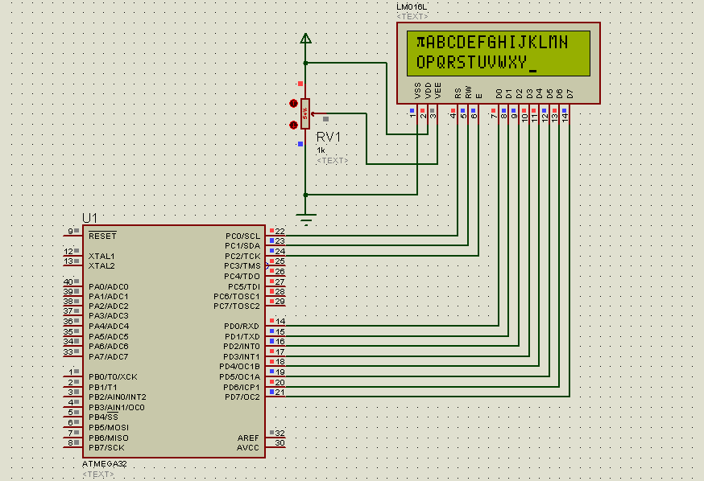
Polling versus Interrupt

Slide 11
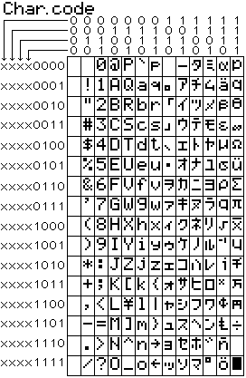
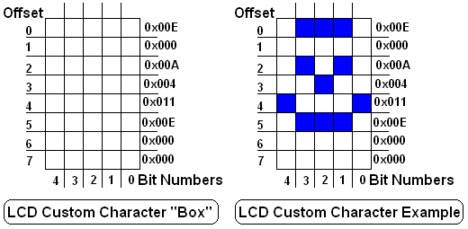
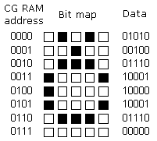
LCD: Show Custom Characters

Slide 12
LCD: Show Custom Characters (1/6)
#include <avr/io.h>
#include <util/delay.h>
#define RS 0 // bit 0 of CTRL_BUS
#define RW 1 // bit 1 of CTRL_BUS
#define E 2 // bit 2 of CTRL_BUS
#define DATA_BUS PORTD
#define DATA_DDR DDRD
#define CTRL_BUS PORTC
#define CTRL_DDR DDRC
const char character[] = {
0b00011111, /* Custom character at address 0 in CG RAM */
0b00010001, /* Character consists of 5 columns and 7 rows */
0b00010001,
0b00010001,
0b00010001,
0b00010001,
0b00011111,
0b00000000,

Slide 13
LCD: Show Custom Characters (2/6)
0b01010, /* Custom character at address 1 in CG RAM */
0b00100,
0b01110,
0b10001,
0b10001,
0b10001,
0b01110,
0b00000,
/* Custom character at address 2 in CG RAM */
0x00, 0x04, 0x08, 0x1F, 0x08, 0x04, 0x00, 0x00,
/* Custom character at address 3 in CG RAM */
0x04, 0x0E, 0x15, 0x04, 0x04, 0x15, 0x0E, 0x04
};
void delay(unsigned int z){ //For delay (Starts)
unsigned int x;
for(x=0 ; x<z ; x++)
_delay_ms(10);
} //Delay Function Ends

Slide 14
LCD: Show Custom Characters (3/6)
int ready(){ //For checking that the LCD is ready or not?
delay(1); return 1;
} //Ready Function Ends
void LCD_Pulse_E(int t){
CTRL_BUS |= (1<<E); // E = 1;
delay(t);
CTRL_BUS &= ~(1<<E); // E = 0;
delay(t);
}
int LCD_Command(unsigned char COMMAND){
ready(); DATA_BUS = COMMAND;
CTRL_BUS &= ~((1<<RS)|(1<<RW));
LCD_Pulse_E(1); return 1;
}

Slide 15
LCD: Show Custom Characters (4/6)
int LCD_Show(unsigned char CHARACTER){
ready(); DATA_BUS = CHARACTER;
CTRL_BUS |= (1<<RS);
CTRL_BUS &= ~(1<<RW);
LCD_Pulse_E(1); return 1;
}
int LCD_Initialize(){
LCD_Command(0x38); // 8 data lines, two lines, Font 5x7.
LCD_Command(0x0E); //Display=ON,Curson=ON,Cursor Blnking=ON
LCD_Command(0x01); // Clear display and cursor at home
LCD_Command(0x06); // During read/write operation only
// cursor (not text) should move right.
LCD_Command(0x80); // Cursor at Line 1, Position 0
return 1;
}

Slide 16
LCD: Show Custom Characters (5/6)
void LCD_CustomChar() {
char i;
LCD_Command(0x40); /* select CGRAM address 0*/
for (i = 0; i<32; i++)
LCD_Show(character[i]);
LCD_Command(0x01); // Cursor Home
LCD_Show(0x00); /* Show Character at CGRAM address 0 */
LCD_Show(0x01); /* Show Character at CGRAM address 1 */
LCD_Show(0x02); /* Show Character at CGRAM address 2 */
LCD_Show(0x03); /* Show Character at CGRAM address 3 */
LCD_Command(0x84); /* select DDRAM location 4*/
}
int main(){
DATA_DDR = 0xFF;
CTRL_DDR = 0xFF;
CTRL_BUS = 0;
DATA_BUS = 0;
unsigned char data1;

Slide 17
LCD: Show Custom Characters (6/6)
for(;;){
delay(500); // wait for LCD to Start
LCD_Initialize();
LCD_CustomChar();
LCD_Show(0xF7); // Shows Pi Sign on LCD
for(data1='A' ; data1 <='D' ; data1++){
delay(50);
LCD_Show(data1);
}
LCD_Command(0xC0); // Cursor at Line 2, Position 0
for(data1='O' ; data1 <='Z' ; data1++){
delay(50);
LCD_Show(data1);
}
delay(500);
}
return 0;
}

Slide 18
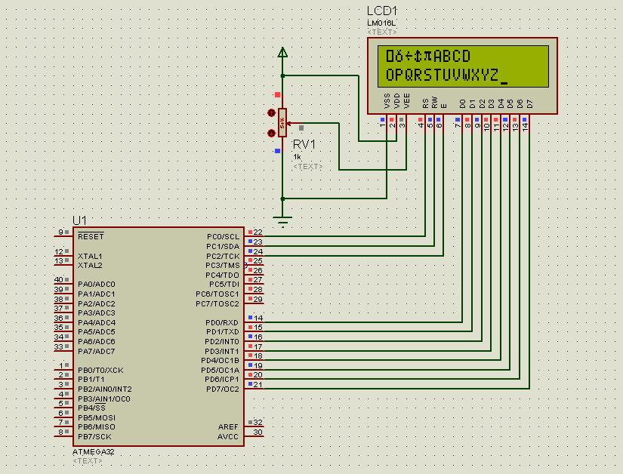

Slide 19
LCD: 4-Wire Interface (1/8)
#include <avr/io.h>
#include <util/delay.h>
#define LCD_DATA PORTD // port connected to LCD data pins
#define DATA_DDR DDRD // direction register for data pins
#define LCD_CTRL PORTD // port connected to LCD control pins
#define CTRL_DDR DDRD // direction register for control pins
#define LCD_RS 0 // define MCU pin connected to LCD RS
#define LCD_RW 1 // define MCU pin connected to LCD R/W
#define LCD_E 2 // define MCU pin connected to LCD E
#define LCD_D0 0 // define MCU pin connected to LCD D0
#define LCD_D1 1 // define MCU pin connected to LCD D1
#define LCD_D2 2 // define MCU pin connected to LCD D1
#define LCD_D3 3 // define MCU pin connected to LCD D2
#define LCD_D4 4 // define MCU pin connected to LCD D3
#define LCD_D5 5 // define MCU pin connected to LCD D4
#define LCD_D6 6 // define MCU pin connected to LCD D5
#define LCD_D7 7 // define MCU pin connected to LCD D6
const unsigned char message1[] =" WWW.HCMIU.EDU.VN";
const unsigned char message2[] =“EEAC, EEEE";

Slide 20
LCD: 4-Wire Interface (2/8)
// additional custom LCD characters
const char character[] = {
0b00011111, /* Custom character at address 0 in CG RAM */
0b00010001, /* Character consists of 5 columns and 7 rows */
0b00010001,
0b00010001,
0b00010001,
0b00010001,
0b00011111,
0b00000000,
0b01010, /* Custom character at address 1 in CG RAM */
0b00100,
0b01110,
0b10001,
0b10001,
0b10001,
0b01110,
0b00000,

Slide 21
LCD: 4-Wire Interface (3/8)
0x00, 0x04, 0x08, 0x1F, 0x08, 0x04, 0x00, 0x00,
/* Custom character at address 2 in CG RAM */
0x04, 0x0E, 0x15, 0x04, 0x04, 0x15, 0x0E, 0x04
/* Custom character at address 3 in CG RAM */
};
void LCD_Command(unsigned char cmd){ //Sends Command to LCD
//4 bit part
LCD_DATA=(cmd&0b11110000); // send upper 4-bits
LCD_CTRL|=1<<LCD_E; // E=1 ,RS=0, RW=0
_delay_ms(1); // keep E=1 for some time
LCD_CTRL&=~(1<<LCD_E); // E=0 ,RS=0, RW=0
_delay_ms(1); // keep E=0 for some time
LCD_DATA=((cmd&0b00001111)<<4); // send lover 4-bits
LCD_CTRL|=1<<LCD_E; // E=1,RS=0,RW=0
_delay_ms(1); // keep E=1 for some time
LCD_CTRL&=~(1<<LCD_E); // E=0,RS=0,RW=0
_delay_ms(1); // keep E=0 for some time
}

Slide 22
LCD: 4-Wire Interface (4/8)
void delay1s(void){ //delay 1s
unsigned char i;
for(i=0;i<100;i++){
_delay_ms(10);
}
}
void LCD_Show(uint8_t ch){ //Sends Char to LCD
LCD_DATA=(ch&0b11110000); // send upper 4-bits
LCD_CTRL|=(1<<LCD_E)|(1<<LCD_RS); // E=1, RS=1
_delay_ms(1); // keep E=1 for some time
LCD_CTRL&=~((1<<LCD_E)); // E=0
_delay_ms(1); // keep E=0 for some time
LCD_DATA=((ch&0b00001111)<<4); // send lower 4-bits
LCD_CTRL|= (1<<LCD_E)|(1<<LCD_RS); // E=1, RS=1
_delay_ms(1); // keep E=1 for some time
LCD_CTRL&=~(1<<LCD_E); // E=0
_delay_ms(1); // keep E=0 for some time
}

Slide 23
LCD: 4-Wire Interface (5/8)
void LCD_init(void){ //Initializes LCD
_delay_ms(15);
LCD_DATA=0x00; // data = 0
LCD_CTRL=0x00; // RS = RW = E = 0
DATA_DDR|=1<<LCD_D7|1<<LCD_D6|1<<LCD_D5|1<<LCD_D4;
// Set bits 4 to 7 as output pins for data out
CTRL_DDR|=1<<LCD_E|1<<LCD_RW|1<<LCD_RS;
// Set bit 0 to 2 as output pins
//---------one------ // DATA = 0x30 ;
LCD_DATA = 0<<LCD_D7|0<<LCD_D6|1<<LCD_D5|1<<LCD_D4; //4 bit mode
// E=1, RW=0, RS=0 for command mode
LCD_CTRL|= 1<<LCD_E|0<<LCD_RW|0<<LCD_RS;
_delay_ms(1); // keep E=1 for some time
// E=0;
LCD_CTRL&=~(1<<LCD_E);
_delay_ms(1); // keep E=0 for some time
//-----------two----------- // DATA = 0x30 ;
LCD_DATA=0<<LCD_D7|0<<LCD_D6|1<<LCD_D5|1<<LCD_D4;
//4 bit mode

Slide 24
LCD: 4-Wire Interface (6/8)
// E=1, RW=0, RS=0 for command mode
LCD_CTRL|=1<<LCD_E|0<<LCD_RW|0<<LCD_RS;
_delay_ms(1); // keep E=1 for some time
LCD_CTRL&=~(1<<LCD_E); // E=0
_delay_ms(1); // keep E=0 for some time
//-------three-------------
// DATA = 0x20 ;
LCD_DATA=0<<LCD_D7|0<<LCD_D6|1<<LCD_D5|0<<LCD_D4; //4 bit mode
// E=1, RW=0, RS=0 for command mode
LCD_CTRL|=1<<LCD_E|0<<LCD_RW|0<<LCD_RS;
_delay_ms(1); // keep E=1 for some time
LCD_CTRL&=~(1<<LCD_E); // E=0
_delay_ms(1); // keep E=0 for some time
//--------4 bit--dual line---------------
LCD_Command(0b00101000); // 0x28
//-----increment address, invisible cursor shift------
LCD_Command(0b00001100); // 0x0C
LCD_Command(0b10000000); // 0x80
}

Slide 25
LCD: 4-Wire Interface (7/8)
void LCD_CustomChar() {
char i;
LCD_Command(0x40); /* select character graphic RAM address 0*/
for (i = 0; i<32; i++)
LCD_Show(character[i]);
LCD_Command(0xC9); // Cursor at line 2 col 9
LCD_Show(0x00); /* Show Character at CGRAM address 0 */
LCD_Show(0x01); /* Show Character at CGRAM address 1 */
LCD_Show(0x02); /* Show Character at CGRAM address 2 */
LCD_Show(0x03); /* Show Character at CGRAM address 3 */
LCD_Command(0x80); /* select DDRAM location 4*/
}
int main(void){
unsigned char i;
LCD_init();//init LCD bit, dual line, cursor right
LCD_Command(0x01); //clears LCD, Cursor at Home

Slide 26
LCD: 4-Wire Interface (8/8)
while(1){ //loop for ever
delay1s(); delay1s();
LCD_Command(0x80); // cursor at upper line most left
LCD_Show(0xF7); // Shows Pi Sign on LCD
for(i=0; message1[i] ;i++){
LCD_Show(message1[i]);
}
LCD_Command(0xC0); // cursor at lower line most left
for(i=0; message2[i] ;i++){
LCD_Show(message2[i]);
}
LCD_CustomChar();
delay1s();
delay1s();
LCD_Command(0x01); //clears LCD, Cursor at Home
}
return 0;
}

Slide 27
